Slide 1

Brief Introduction of Java 7
Subtitle
Notes:
To change the image on this slide, select the picture and delete it. Then click the Pictures icon in the placeholder to insert your own image.

Slide 2
Contents
Introducing Java 7
NIO2

Slide 3
Title and Content Layout with Chart
The Java language
“A Brief, Incomplete, and Mostly Wrong History of Programming Languages.”
-- James Iry

Slide 4
Two Content Layout with Table
The Java Platform

Slide 5
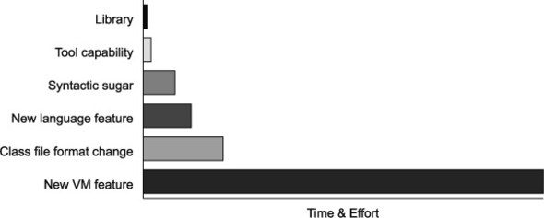
Project Coin
The goal of Project Coin is to determine what set of small language changes should be added to JDK7. (After discussion, 5 out of 70 proposals were selected for JDK7)
Java7 is the first version developed in an open source manner

Slide 6
Project Coin Proposal Judgement Rules
Submit a detailed proposal form describing their change (which should fundamentally be a Java language change, rather than a virtual machine change)
Discuss their proposal openly on a mailing list and field constructive criticism from the other participants
Be prepared to produce a prototype set of patches that could implement their change

Slide 7
Add a Slide Title - 4
Project Coin brought six main new features to Java7:
Strings in switch
Enhanced syntax for numeric literals
Improved exception handling
Try-with-resources
Diamond syntax
Simplified varargs method invocation

Slide 9
Path
The concept of a location
JVM only binds a Path to the physical location at runtime

Slide 10
NIO.2
FileAttribute
PosixFilePermission

Slide 11
NIO.2
Be careful when writing filesystem-specific code. Always ensure that your logic and exception handling covers the case where your code might run on a different filesystem.

Slide 12
Reading and writing data
Provide bridge to io
BufferReader and BufferWriter
InputStream and OutputStream
Provide new reading and writing
Files.readAllLines

Slide 13
File change notification
Event notification: This class uses client threads to keep an eye on registered files or directories for changes, and will return an event when a change is detected.
Good to replace polling mechanisms

